Slide 1
Результат работы программы
Unnamed: 0 Word1 Word2 Word3 Answer 2s_acc 7s_acc 7s_st 7s_sd 15s_acc 15s_st 15s_sd 30s_acc 30s_st 30s_sd IN_G
0 0 cottage swiss cake cheese 52 84 3.28 1.25 96 3.96 2.37 64.0 10.85 7.04 True
1 1 cream skate water ice 34 76 3.42 1.16 92 4.04 1.87 90.0 4.12 3.58 True
2 2 loser throat spot sore 22 61 4.19 1.49 86 5.38 3.02 82.0 6.31 4.06 True
3 3 show life row boat 31 72 4.42 1.44 82 5.67 2.34 79.0 10.30 7.22 True
4 4 night wrist stop watch 38 65 4.33 1.31 82 6.00 3.00 97.0 6.27 5.83 True
.. ... ... ... ... ... ... ... ... ... ... ... ... ... ... ... ...
112 139 way ground weather fair 0 5 5.53 1.39 1 3.11 0.00 10.0 17.04 5.48 True
113 140 cast side jump broad 0 1 3.56 0.00 0 0.00 0.00 5.0 10.81 0.00 True
114 141 back step screen door 0 2 5.47 0.53 0 0.00 0.00 33.0 7.73 2.57 True
115 142 reading service stick lip 1 1 6.11 0.00 0 0.00 0.00 10.0 9.57 8.00 True
116 143 over plant horse power 0 1 5.45 0.00 0 0.00 0.00 10.0 18.30 5.26 True
Nodes: 4
Edges: 4
Density: 0.3333333333333333
Transitivity 0
False
1
Nodes: 4
Edges: 4
Density: 0.6666666666666666
Transitivity 0
True
4

Slide 2
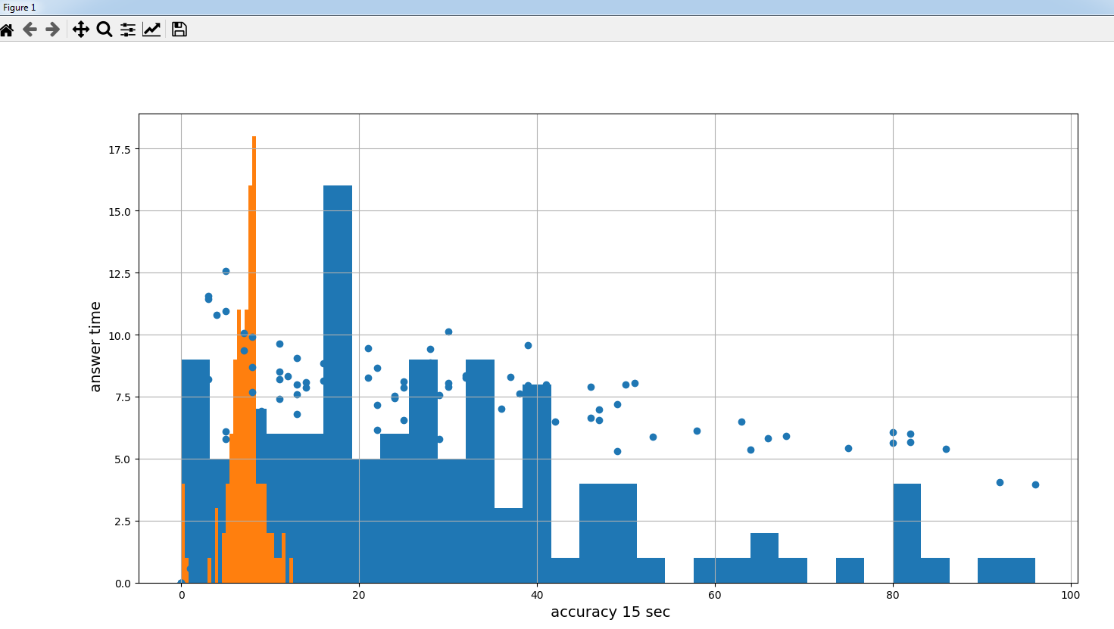

Slide 3
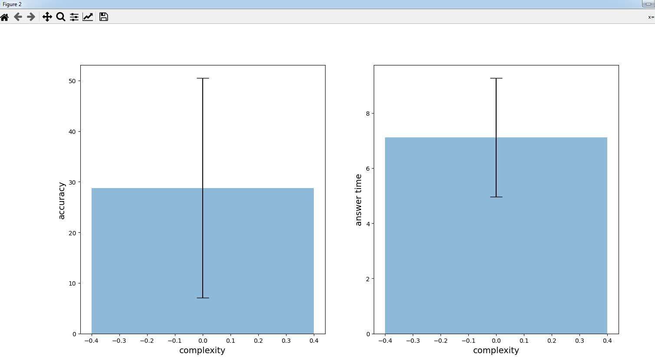

Slide 4
Код для определения значений веса рёбер в заранее заданной сети
import igraph as ig
import matplotlib.pyplot as plt
import numpy as np
import pandas as pd
#%matplotlib inline
import networkx as nx
links = [[1, 2], [1, 3], [2, 4], [1, 2]]
vertices = [v for s in links for v in s] # = [1,2,1,3,2,4,1,2]
g = ig.Graph()
g.add_vertices(vertices)
for l in links:
g.add_edge(l[0], l[1], weight=0.5*l[0]*l[1]) # weight value is just an example
print(g)
print("\nEdges\n")
for e in g.es():
print("source: %s target: %d" % (e.source, e.target))
print("multiplicity %d" % (g.count_multiple(e)))
print("weight %f\n" % e['weight'])
Результат работы программы:
+ attr: name (v), weight (e)
+ edges (vertex names):
2--1, 2--3, 1--2, 2--1
Edges
source: 1 target: 2
multiplicity 2
weight 1.000000
source: 1 target: 3
multiplicity 1
weight 1.500000
source: 2 target: 4
multiplicity 1
weight 4.000000
source: 1 target: 2
multiplicity 2
weight 1.000000

